Slide 1


Slide 2
A Project on
Super Market Data set for Predictive Analysis .

Slide 3

In partial fulfilment of the requirements for the award of MASTER OF SCIENCE IN STATISTICS
Predictive Analysis
DEPARTMENT OF STATISTICS
UNIVERSITY COLLEGE OF SCIENCE
OSMANIA UNIVERSITY HYDERABAD – INDIA
Done By
DEVARAKONDA SATYA ALEKHYA Roll No:1006-21-507-001
CHERUKU UMA DEVI Roll No :1006-21-507-009
AKKENA NITYA Roll No:1006-21-507-017
MALE NIKITHA Roll No:1006-21-507-027
SHAIK SANA Roll No:1007-21-507-036
GOUDAMPALLY ARCHANA Roll No:1007-21-507-044

Slide 4

Machine learning
Predictive Analysis
Artificial Intelligence(AI): Creating the intelligence system which behave like human brain.
Machine learning : Machine learning is the learning of the input
without giving the code explicitly and getting output
Machine learning can be also said as
R L O
Representation of data Learning of data Optimization

Slide 5
Overview of datamining/Modelling process
Predictive Analysis
KDD - Knowledge Discovery in database
CRISP-DM - Cross Industry Standard Process for Datamining
SEMMA - Sample Explore Modify Model and Assess

Slide 6
CRISP-DM (Cross Industry Standard Process for Data Mining
CRISP-DM is an open standard process model that describes common approaches used by data mining expert .
It is the most widely used analytics model.
There is a cyclic nature of data mining.
Data mining process continues after solution has been deployed.

Slide 7
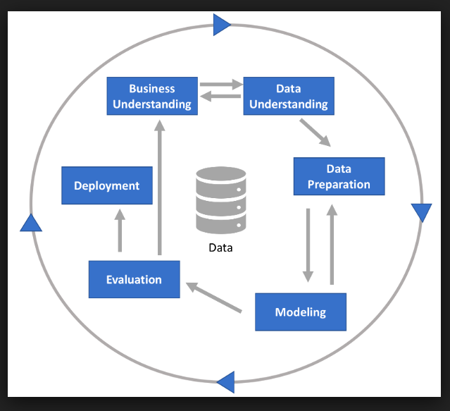
PHASES IN CRISP-DM

Slide 8
BUSINESS UNDERSTANDING

Slide 9

Scope of the problem
Predictive Analysis
The hunters e-grocery brand is present in 10 countries and are looking for new ways to improve and anticipate their customer needs based on customer behaviour.
so we are using the data set propose business value for informative based decision making.

Slide 10
Source: https://www.kaggle.com/datasets/hunter0007/ecommerce-dataset-for-predictive-marketing-2023
Description:
The data is extracted fromKaggle.com, data has 2019501 columns and 12 columns.

Slide 11
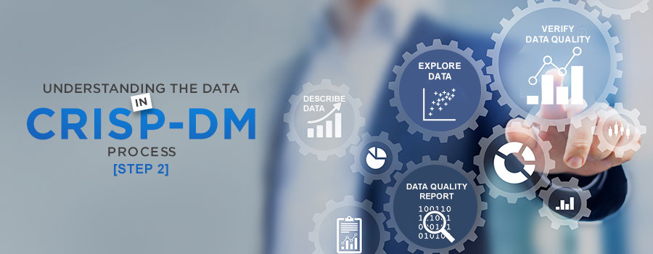
DATA UNDERSTANDING

Slide 12

Description
Predictive Analysis
order_id – (A unique number to identity the order)
user_id - (A unique number to identify the user)
order_number – (Number of the order)
order_dow – (Day of the Week the order was made)
order_hour_of_day – (Time of the order)
days_since_prior_order - (History of the order)
product_id – (Id of the product)
add_to_cart_order – (Number of items added to cart)
reordered – (If the reorder took place)
department_id - (Unique number allocated to each department)
department – (Names of the departments)
product_name – (Name of the products)

Slide 13

user_id | order_number | order_dow | order_hour_of_day | days_since_prior_order | product_id | add_to_cart_order | reordered | department_id | department | product_name
49125 | 1 | 2 | 18 |  | 17 | 1 | 0 | 13 | pantry | baking ingredients
49125 | 1 | 2 | 18 |  | 91 | 2 | 0 | 16 | dairy eggs | soy lactosefree
49125 | 1 | 2 | 18 |  | 36 | 3 | 0 | 16 | dairy eggs | butter
49125 | 1 | 2 | 18 |  | 83 | 4 | 0 | 4 | produce | fresh vegetables
49125 | 1 | 2 | 18 |  | 83 | 5 | 0 | 4 | produce | fresh vegetables
49125 | 1 | 2 | 18 |  | 91 | 6 | 0 | 16 | dairy eggs | soy lactosefree
49125 | 1 | 2 | 18 |  | 120 | 7 | 0 | 16 | dairy eggs | yogurt
49125 | 1 | 2 | 18 |  | 59 | 8 | 0 | 15 | canned goods | canned meals beans
49125 | 1 | 2 | 18 |  | 35 | 9 | 0 | 12 | meat seafood | poultry counter
162867 | 1 | 3 | 17 |  | 37 | 1 | 0 | 1 | frozen | ice cream ice
162867 | 1 | 3 | 17 |  | 24 | 2 | 0 | 4 | produce | fresh fruits
162867 | 1 | 3 | 17 |  | 83 | 3 | 0 | 4 | produce | fresh vegetables
162867 | 1 | 3 | 17 |  | 84 | 4 | 0 | 16 | dairy eggs | milk
162867 | 1 | 3 | 17 |  | 91 | 5 | 0 | 16 | dairy eggs | soy lactosefree
162867 | 1 | 3 | 17 |  | 24 | 6 | 0 | 4 | produce | fresh fruits
162867 | 1 | 3 | 17 |  | 24 | 7 | 0 | 4 | produce | fresh fruits
162867 | 1 | 3 | 17 |  | 24 | 8 | 0 | 4 | produce | fresh fruits
162867 | 1 | 3 | 17 |  | 21 | 9 | 0 | 16 | dairy eggs | packaged cheese
162867 | 1 | 3 | 17 |  | 112 | 10 | 0 | 3 | bakery | bread
162867 | 1 | 3 | 17 |  | 24 | 11 | 0 | 4 | produce | fresh fruits

Slide 14
162867 | 1 | 3 | 17 |  | 24 | 12 | 0 | 4 | produce | fresh fruits
162867 | 1 | 3 | 17 |  | 24 | 13 | 0 | 4 | produce | fresh fruits
147243 | 14 | 0 | 16 | 3 | 94 | 1 | 0 | 7 | beverages | tea
147243 | 14 | 0 | 16 | 3 | 83 | 2 | 0 | 4 | produce | fresh vegetables
147243 | 14 | 0 | 16 | 3 | 83 | 3 | 1 | 4 | produce | fresh vegetables
147243 | 14 | 0 | 16 | 3 | 24 | 4 | 1 | 4 | produce | fresh fruits
147243 | 14 | 0 | 16 | 3 | 120 | 5 | 1 | 16 | dairy eggs | yogurt
147243 | 14 | 0 | 16 | 3 | 120 | 6 | 1 | 16 | dairy eggs | yogurt
147243 | 14 | 0 | 16 | 3 | 91 | 7 | 1 | 16 | dairy eggs | soy lactosefree
147243 | 14 | 0 | 16 | 3 | 120 | 8 | 1 | 16 | dairy eggs | yogurt
147243 | 14 | 0 | 16 | 3 | 120 | 9 | 1 | 16 | dairy eggs | yogurt
147243 | 14 | 0 | 16 | 3 | 8 | 10 | 0 | 3 | bakery | bakery desserts
147243 | 14 | 0 | 16 | 3 | 24 | 11 | 1 | 4 | produce | fresh fruits
147243 | 14 | 0 | 16 | 3 | 52 | 12 | 0 | 1 | frozen | frozen breakfast
147243 | 14 | 0 | 16 | 3 | 36 | 13 | 1 | 16 | dairy eggs | butter
147243 | 14 | 0 | 16 | 3 | 121 | 14 | 0 | 14 | breakfast | cereal
147243 | 14 | 0 | 16 | 3 | 86 | 15 | 0 | 16 | dairy eggs | eggs
195275 | 81 | 1 | 11 | 3 | 83 | 1 | 1 | 4 | produce | fresh vegetables
195275 | 81 | 1 | 11 | 3 | 86 | 2 | 1 | 16 | dairy eggs | eggs

Slide 15
195275 | 81 | 1 | 11 | 3 | 24 | 3 | 1 | 4 | produce | fresh fruits
195275 | 81 | 1 | 11 | 3 | 24 | 4 | 1 | 4 | produce | fresh fruits
195275 | 81 | 1 | 11 | 3 | 43 | 5 | 1 | 3 | bakery | buns rolls
195275 | 81 | 1 | 11 | 3 | 120 | 6 | 1 | 16 | dairy eggs | yogurt
195275 | 81 | 1 | 11 | 3 | 24 | 7 | 1 | 4 | produce | fresh fruits
195275 | 81 | 1 | 11 | 3 | 83 | 8 | 1 | 4 | produce | fresh vegetables
195275 | 81 | 1 | 11 | 3 | 83 | 9 | 1 | 4 | produce | fresh vegetables
195275 | 81 | 1 | 11 | 3 | 83 | 10 | 1 | 4 | produce | fresh vegetables
195275 | 81 | 1 | 11 | 3 | 24 | 11 | 1 | 4 | produce | fresh fruits
58222 | 3 | 6 | 11 | 6 | 53 | 1 | 1 | 16 | dairy eggs | cream
58222 | 3 | 6 | 11 | 6 | 86 | 2 | 1 | 16 | dairy eggs | eggs
58222 | 3 | 6 | 11 | 6 | 115 | 3 | 1 | 7 | beverages | water seltzer sparkling water
58222 | 3 | 6 | 11 | 6 | 120 | 4 | 0 | 16 | dairy eggs | yogurt
58222 | 3 | 6 | 11 | 6 | 17 | 5 | 0 | 13 | pantry | baking ingredients
58222 | 3 | 6 | 11 | 6 | 17 | 6 | 1 | 13 | pantry | baking ingredients
58222 | 3 | 6 | 11 | 6 | 17 | 7 | 0 | 13 | pantry | baking ingredients
58222 | 3 | 6 | 11 | 6 | 24 | 8 | 0 | 4 | produce | fresh fruits
58222 | 3 | 6 | 11 | 6 | 110 | 9 | 0 | 13 | pantry | pickled goods olives
58222 | 3 | 6 | 11 | 6 | 49 | 10 | 0 | 12 | meat seafood | packaged poultry
58222 | 3 | 6 | 11 | 6 | 83 | 11 | 0 | 4 | produce | fresh vegetables
15

Slide 16
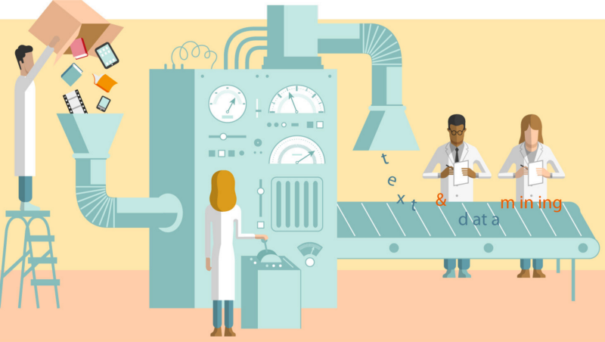
Data PREPARATION

Slide 17

Predictive Analysis
Checking the dimensions of the data: dataset.shape:
Checking for the variable names and their datatypes in the data:
dataset.dtypes:
2019501 rows × 12 columns
order_id : int64
user_id : int64
order_number : int64
order_dow : int64
order_hour_of_day : int64
days_since_prior_order : float64
product_id : int64
add_to_cart_order : int64
reordered : int64
department_id : int64
department : object
product_name : object
dtype: : object

Slide 18
Predictive Analysis
Checking for the null values . dataset.isnull().sum()
order_id : 0
user_id : 0
order_number : 0
order_dow : 0
order_hour_of_day : 0
days_since_prior_order : 124342
product_id : 0
add_to_cart_order : 0
Reordered : 0
department_id : 0
Department : 0
product_name : 0
Dtype : int64
order_id :0
user_id :0
order_number :0
order_dow :0
order_hour_of_day :0
days_since_prior_order :0
product_id :0 add_to_cart_order :0
Reordered :0
department_id :0
Department :0
product_name :0
Dtype :int64

Slide 19
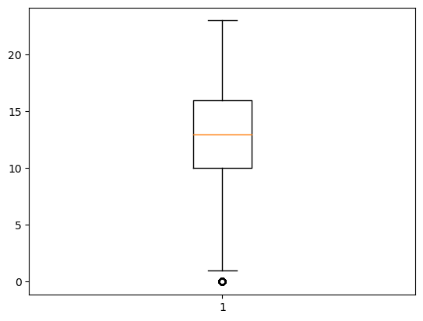
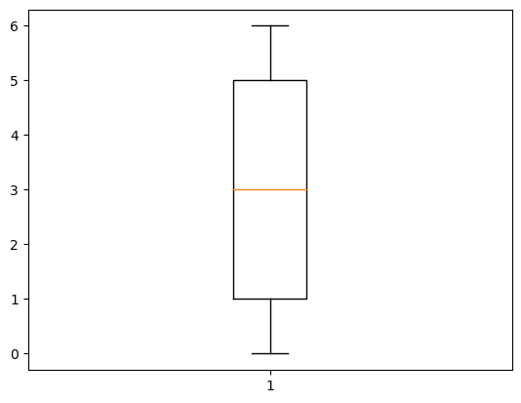
Box plot BEFORE REMOVING OUTLIERS
Predictive Analysis
BOX PLOT AFTER REMOVING OUTLIERS

Slide 20
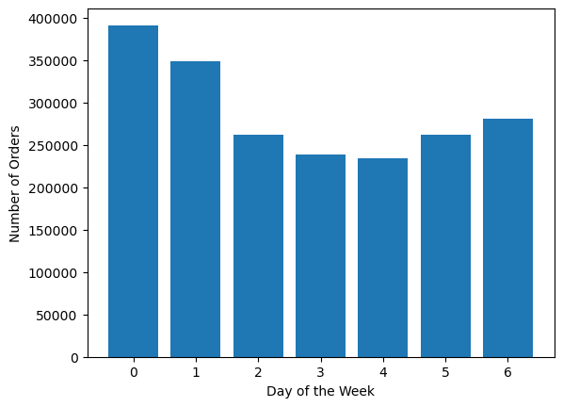
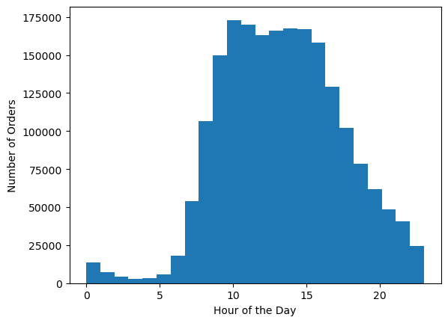
Predictive Analysis
HISTOGRAM FOR HOUR OF THE DAY AND NUMBER OF ORDERS
BAR GRAPH FOR DAYS OF WEEK AND NUMBER OF ORDERS

Slide 21
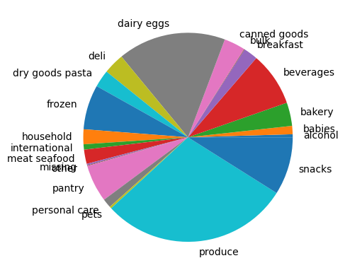
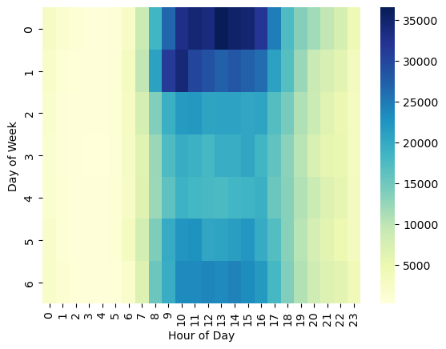
PIE CHART FOR MOST USED DEPARTMENT
Predictive Analysis
HEAT MAP FOR ORDER ID AND HOUR OF THE DAY

Slide 22
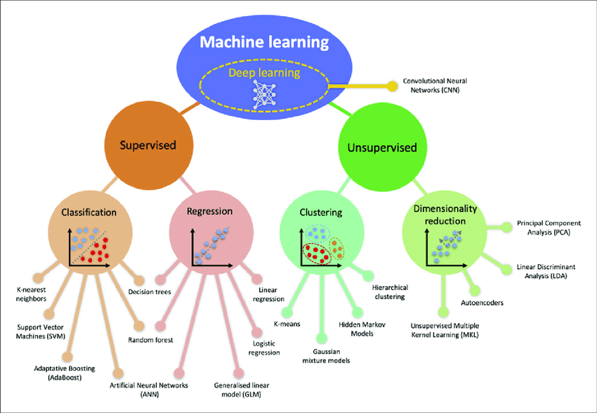
MODELING

Slide 23
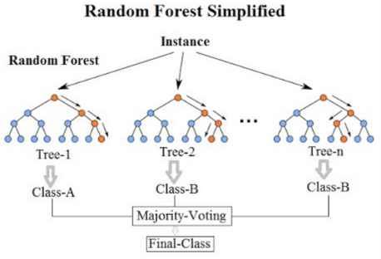
RANDOM FOREST
Predictive Analysis
Random Forest is a popular ensemble learning algorithm used for classification, regression, and other machine learning tasks . It creates multiple decision trees and combine them make final predictions , it is less prone to over fitting and perform well on a wide range of data sets .
To create a diverse set of decision trees by introducing randomness into the tree construction process. This is done by using a combination of two techniques: bagging and random feature selection.
Random feature selection involves randomly selecting a subset of the features at each split of the decision tree. This helps to decorrelate the trees and improve their diversity, as different trees will use different subsets of the features.
Estimating biases using als... Computing the pearson_baseline similarity matrix... Done computing similarity matrix.
Out[38]:
[104, 132, 26, 84, 124, 54, 110, 103, 75, 17]
Number of churn: 1193

Slide 24
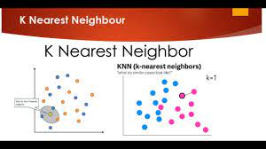
KNN - K NEAREST NEIGHBOURHOOD
Predictive Analysis
K-Nearest Neighbors (KNN) is a non-parametric method that does not make any assumptions about the underlying data distribution.
One of the strengths of the KNN algorithm is its simplicity and interpretability, as the algorithm is based on a straightforward principle of finding similar data points.
It is also a versatile algorithm that can be used for various types of data and applications, including image recognition, text classification, and recommendation systems.
array([0, 0, 1, ..., 0, 1, 0])

Slide 25
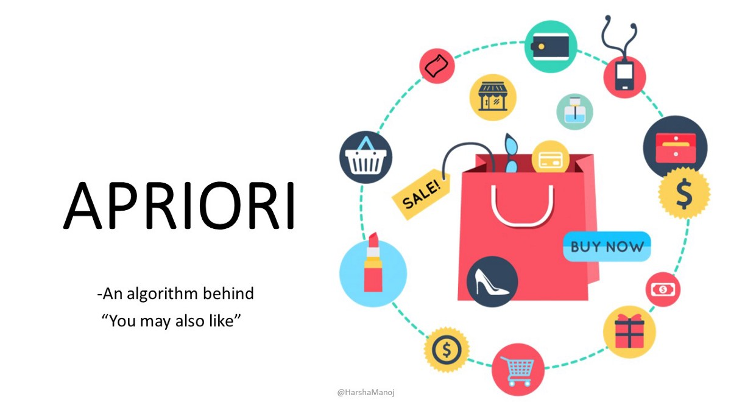
Predictive Analysis
Apriori algorithm
Apriori algorithm is an algorithm for frequent item set mining and the association rule learning over relational databases It is based on the principle of association rule mining, which aims to discover associations and correlations among items in large datasets.
The Apriori algorithm uses a bottom-up approach, where it starts by identifying all individual items that appear in the dataset .
The algorithm prunes the search space by using the Apriori property, which states that any subset of a frequent itemset must also be frequent. This reduces the number of itemset that need to be considered and speeds up the algorithm.

Slide 26
Predictive Analysis
support | itemsets
0 | 0.0055 | (air fresheners candles)
1 | 0.0375 | (asian foods)
2 | 0.0520 | (baby food formula)
3 | 0.0100 | (bakery desserts)
4 | 0.0780 | (baking ingredients)
... | ... | ...
14363 | 0.0085 | (fresh vegetables, fresh fruits, packaged vege...
14364 | 0.0050 | (water seltzer sparkling water, fresh vegetabl...
14365 | 0.0060 | (other creams cheeses, fresh vegetables, fresh...
14366 | 0.0055 | (fresh vegetables, refrigerated, fresh fruits,...
14367 | 0.0055 | (water seltzer sparkling water, fresh vegetabl...

Slide 27
APRIORI algorithm RULES
Support: The support of an itemset is defined as the proportion of transactions that contain that itemset. It measures how frequently an itemset appears in the dataset. A high support value indicates that the itemset is a popular one among the transactions. It can be calculated as follows:
Lift: The lift of a rule is the ratio of the observed frequency of co-occurrence of the items in the antecedent and consequent to the expected frequency of their co-occurrence if the items were independent. In other words, lift measures the degree of association between the antecedent and consequent, compared to what would be expected if they were independent. A lift value greater than 1 indicates that the antecedent and consequent are positively associated, while a value less than 1 indicates a negative association.
Confidence: The confidence of a rule is the conditional probability that the consequent appears in a transaction, given that the antecedent is present in that transaction. In other words, confidence measures the strength of the association between the antecedent and consequent. A high confidence value indicates that the rule is a reliable one, and is likely to be true. It can be calculated as follows:
In summary, support measures how frequent an itemset is, lift measures the degree of association between the antecedent and consequent, and confidence measures the strength of the association between the antecedent and consequent. These measures are useful in evaluating the quality of the association rules discovered using the Apriori algorithm, and can be used to filter out weak rules and focus on the more meaningful ones.

Slide 28
Predictive Analysis
antecedents | consequents | antecedent support | consequent support | support | confidence | lift | leverage | conviction
0 | (baking ingredients) | (asian foods) | 0.0710 | 0.0460 | 0.0065 | 0.091549 | 1.990202 | 0.003234 | 1.050140
1 | (asian foods) | (baking ingredients) | 0.0460 | 0.0710 | 0.0065 | 0.141304 | 1.990202 | 0.003234 | 1.081873
2 | (bread) | (asian foods) | 0.1610 | 0.0460 | 0.0080 | 0.049689 | 1.080205 | 0.000594 | 1.003882
3 | (asian foods) | (bread) | 0.0460 | 0.1610 | 0.0080 | 0.173913 | 1.080205 | 0.000594 | 1.015632
4 | (breakfast bakery) | (asian foods) | 0.0725 | 0.0460 | 0.0055 | 0.075862 | 1.649175 | 0.002165 | 1.032313
... | ... | ... | ... | ... | ... | ... | ... | ... | ...
145607 | (fresh vegetables) | (packaged vegetables fruits, yogurt, milk, fro... | 0.4670 | 0.0090 | 0.0060 | 0.012848 | 1.427552 | 0.001797 | 1.003898
145608 | (milk) | (packaged vegetables fruits, yogurt, fresh veg... | 0.2480 | 0.0085 | 0.0060 | 0.024194 | 2.846300 | 0.003892 | 1.016083
145609 | (frozen produce) | (packaged vegetables fruits, yogurt, fresh veg... | 0.1210 | 0.0165 | 0.0060 | 0.049587 | 3.005259 | 0.004004 | 1.034813
145610 | (fresh fruits) | (packaged vegetables fruits, yogurt, fresh veg... | 0.5715 | 0.0060 | 0.0060 | 0.010499 | 1.749781 | 0.002571 | 1.004546
145611 | (packaged cheese) | (packaged vegetables fruits, yogurt, fresh veg... | 0.2460 | 0.0095 | 0.0060 | 0.024390 | 2.567394 | 0.003663 | 1.015263

Slide 29
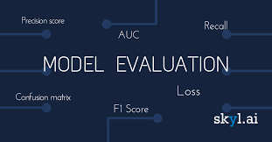
EVALUATION

Slide 30
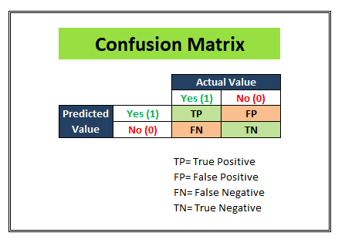

CONFUSION MATRIX
Predictive Analysis
A confusion matrix is a performance evaluation tool used to assess the performance of a classification algorithm. It is a table that summarizes the predicted and actual classifications of a dataset, where each row represents the true class and each column represents the predicted class.
Accuracy is the proportion of correctly classified samples out of the total number of samples in the dataset
Precision is the proportion of correctly predicted positive samples out of the total number of positive predictions:
Recall, also known as sensitivity or true positive rate, is the proportion of correctly predicted positive samples out of the total number of actual positive samples:
F1 score is the harmonic mean of precision and recall, which gives equal weight to both measures
In the context of association rule mining using the Apriori algorithm, support, lift, and confidence are three important measures that are used to evaluate the strength of the discovered association rules.
[[19000 861]
[ 93 1100]]

Slide 31

DEPLOYEMENT

Slide 32
SUMMARY
Predictive Analysis
The inference gives us the frequent item set found by the apirior algorithm and also association rules are printed out
The method returns a list of the n recommendations most similar products to those that the user has already reordered, based on the similarity scores calculated during training. The output of predictions is a list of tuples, where each tuple contains the ID of a recommended product and its similarity score (i.e., how similar the product is to the products that the user has already reordered).
Finally the model makes predictions on the test set and predicated churn values are outputted as an array .

Slide 33
THANK YOU
Predictive Analysis
DEVARAKONDA SATYA ALEKHYA
CHERUKU UMA DEVI
AKKENA NITYA
MALE NIKITHA
SHAIK SANA
GOUDAMPALLY ARCHANA

